Slide 1
Multimodal Retrieval-Augmented Generation (mRAG) on MMDocIR
By: Kiran Vågen, Gabriel Paulo Maglalang Israel, Oluwatobi Togun, Ørjan Rode Østlyngen

Slide 2
AI disclosure
AI was used, so we enforced strict consistency. Key guidelines:
Singe source of truth in config.py and inheritance from base classes
Domain based structure
Keep code shallow (max ~5 indents)
Linting formatting, docstrings
Cache all steps for speed, with multiprocessing, threading, and logging

Slide 3
Tools & Libraries
Pdf Processor: Docling
Vector Database: Qdrant
Embedder: Jina Clip 2 (Text + Images)
Exact Word Matching: Bm25
Agent Framework: LangChain
Agent ProcessFlow: LangGraph

Slide 4
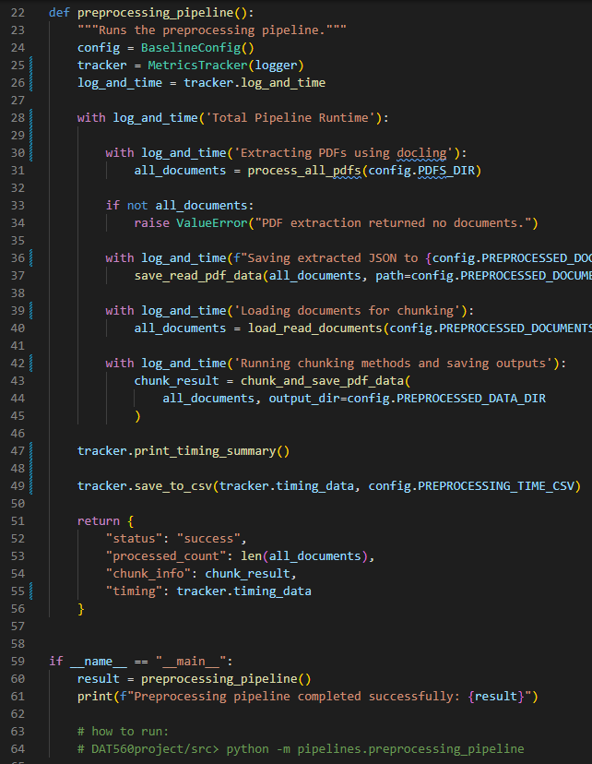
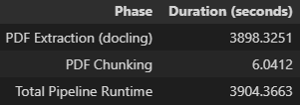
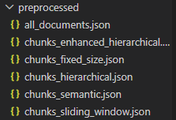
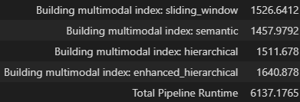
Preprocessing
Unstructured (bad for semantic chunking)
Docling
Key problem: capping chunk sizes so the embedder doesnt crash

Slide 5
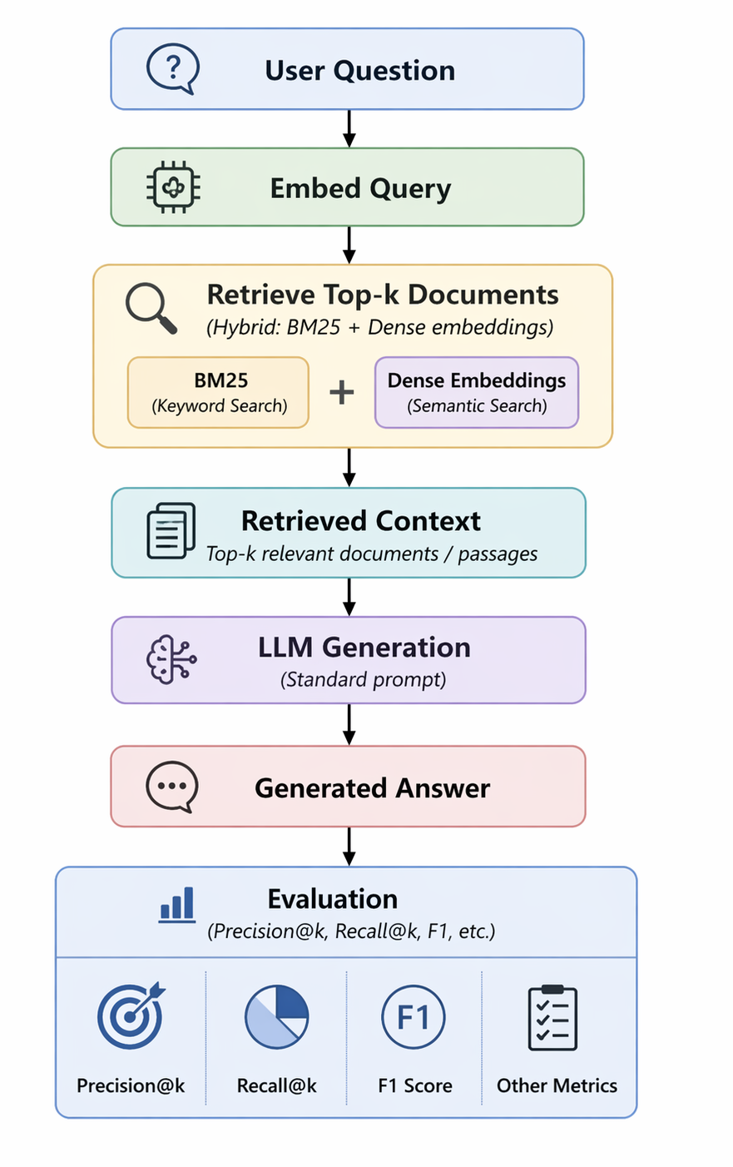
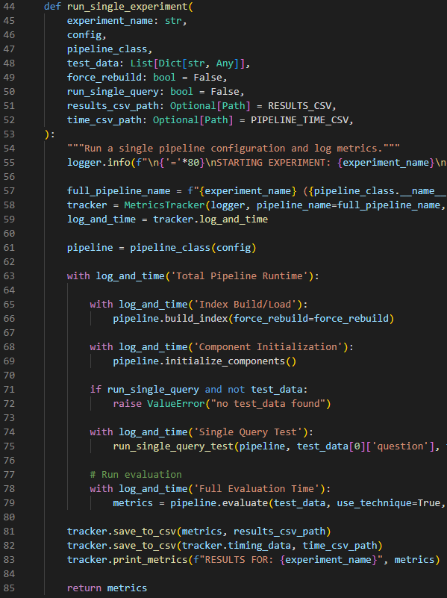
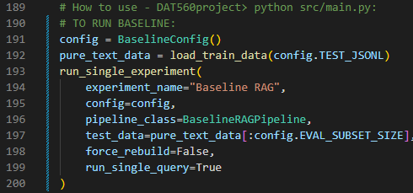
System 1. Baseline
All pipeline process flow run through a single function.

Slide 6
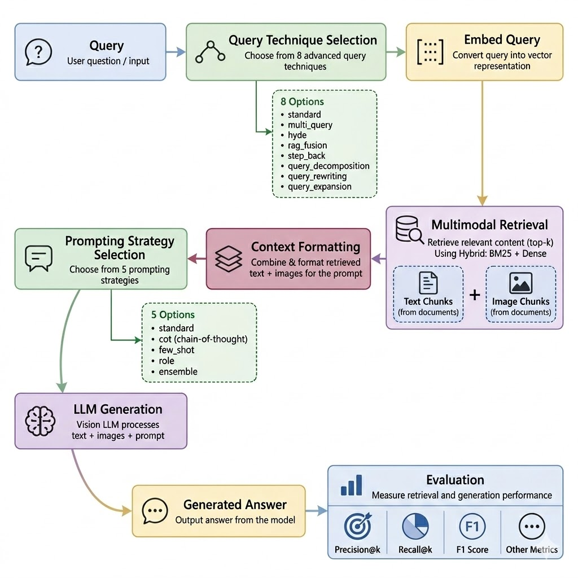
System 2. Advanced

Slide 7
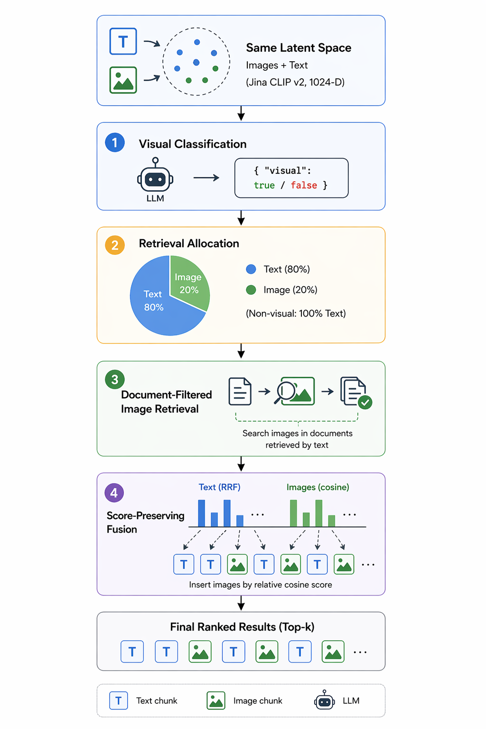
System 2. Multimodal
Same latent space
Visual Classification
Retrieval Allocation
Document Filtered Image Retrieval
Score Preserving Fusion

Slide 8
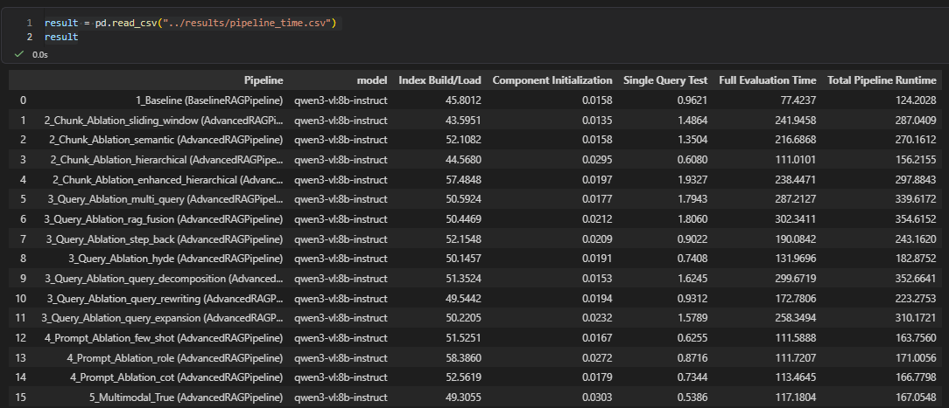
System 2. Ablations time (first run - not cached)
Bottleneck

Slide 9
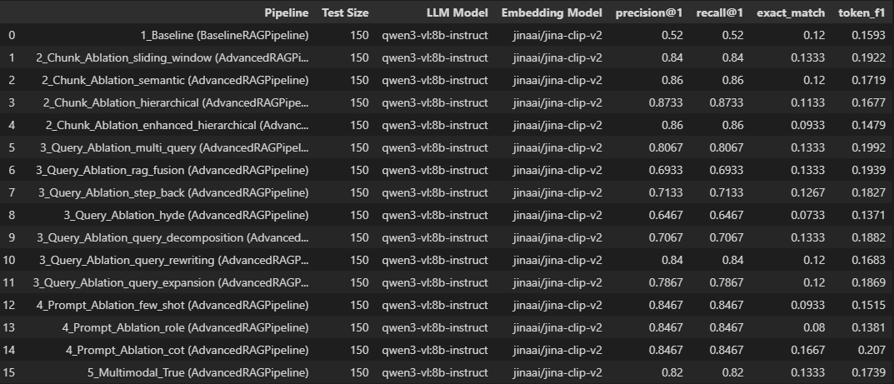
System 2. Ablations Metrics (Initial results)
We decided to keep using multimodal(image) as the default for system 2.

Slide 10
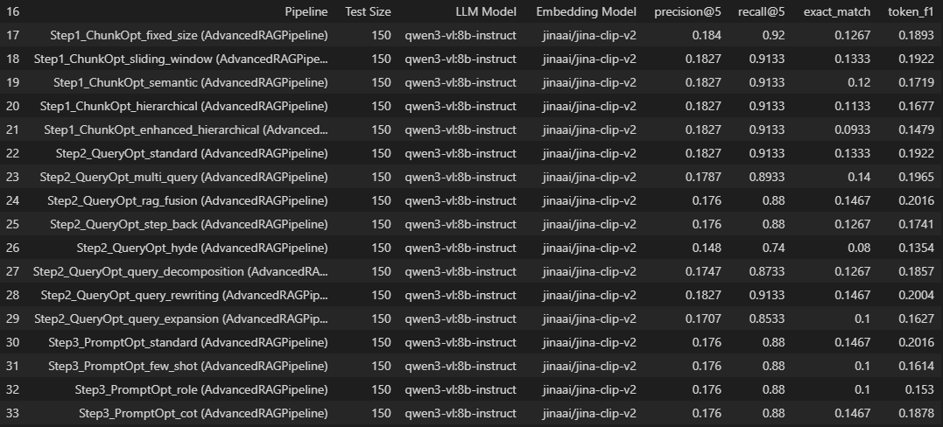
System 2. Combining strategies (Incremental optimization)
on token_f1 score
Using iterative optimization, selecting the best variant of each component at every step and carrying it forward into the next stage.
Step 1. Chunking_strategy: Sliding window
Step 2. Query technique: rag_fusion
Step 3.prompting strategy: standard
token_f1 score didnt do that well with this method

Slide 11
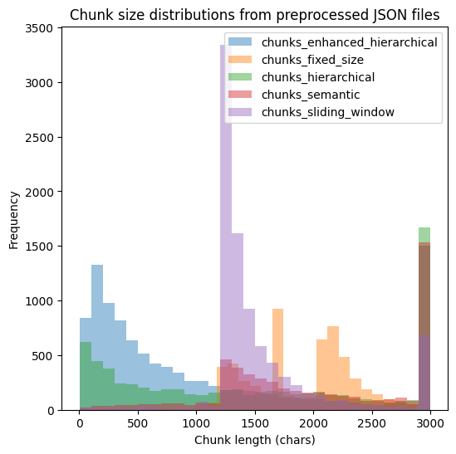
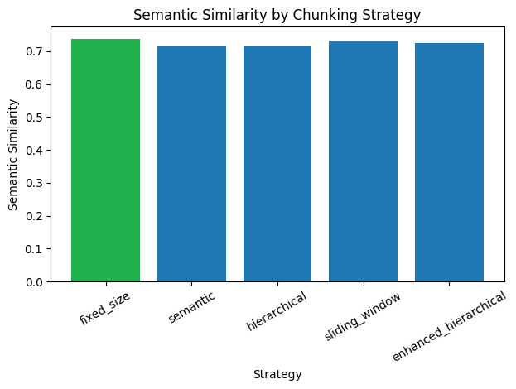
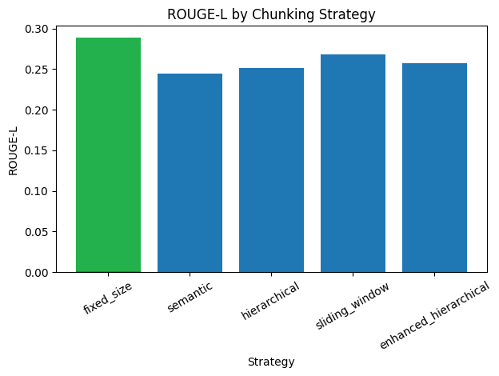
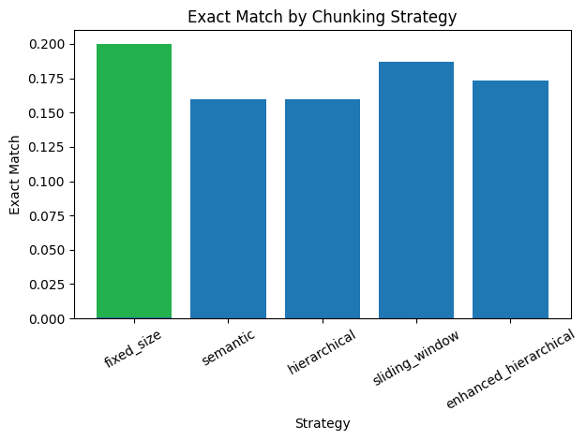
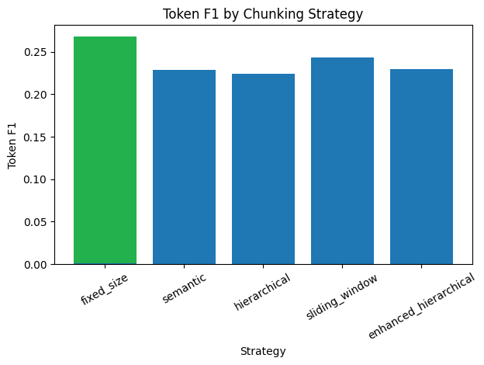
System 2. Chunking Strategies Generation Metrics
Best Generation Metric: Fixed-Size Chunking
Reason: Large enough chunk length to include all necessary information than other strategies

Slide 12
System 2. Chunking Strategies Retrieval Metrics
Chunking strategy | P@1 | P@3 | P@5 | R@1 | R@3 | R@5 | NDCG@1 | MAP | MRR
Fixed-size | 0.8467 | 0.300 | 0.1827 | 0.8467 | 0.900 | 0.9133 | 0.8467 | 0.8733 | 0.8733
Semantic | 0.8667 | 0.2978 | 0.1800 | 0.8667 | 0.8933 | 0.9000 | 0.8667 | 0.8813 | 0.8813
Hierarchical | 0.8667 | 0.3044 | 0.1027 | 0.8667 | 0.9133 | 0.9133 | 0.8667 | 0.8878 | 0.8878
Sliding Window | 0.833 | 0.3022 | 0.1827 | 0.8333 | 0.9067 | 0.9133 | 0.8333 | 0.8680 | 0.8680
Enhanced Hierarchical | 0.7133 | 0.2933 | 0.1800 | 0.7133 | 0.8800 | 0.9000 | 0.7133 | 0.7983 | 0.7983

Slide 13
System 2. Query Processing
👑Standard👑
Multi-Query
RAG-Fusion
Step-Back
HyDe
Query-Expansion
Query-Rewriting
Query-Decomposition
Query Techique | Precision@1 | Recall@1 | Token F1 | Exact Match | Semantic Similarity
Standard | 0.847 | 0.847 | 0.268 | 0.200 | 0.738
Step-Back | 0.707 | 0.707 | 0.253 | 0.187 | 0.723
Multi | 0.793 | 0.793 | 0.251 | 0.187 | 0.724
Rag-Fusion | 0.687 | 0.687 | 0.230 | 0.173 | 0.698
HyDe | 0.653 | 0.653 | 0.190 | 0.133 | 0.700
Expansion | 0.780 | 0.780 | 0.227 | 0.147 | 0.700
Rewriting | 0.833 | 0.833 | 0.227 | 0.173 | 0.700
Decomposition | 0.700 | 0.700 | 0.244 | 0.167 | 0.714

Slide 14
System 2. Query Processing
Model: 8b
Worse Query
Lose Semantic context
HyDe Suffer Greatly
Ensemble not good for RAG

Slide 15
System 2. Prompt Strategy
Semantic Similarity
Standard
👑Chain Of Thought (CoT)👑
Few-Shot
Role (Rag specialist)
Why:
Reasoning Questions
Model: 8b
Bad examples
No good role for all
Query Techique | Token F1 | BLEU | ROUGE1 | Exact Match | Semantic Similarity
Standard | 0.2681 | 0.2325 | 0.2913 | 0.200 | 0.7377
CoT | 0.2858 | 0.2492 | 0.3062 | 0.2267 | 0.6988
Few-Shot | 0.1752 | 0.1330 | 0.1830 | 0.1133 | 0.6051
Role | 0.1342 | 0.0915 | 0.1459 | 0.1000 | 0.5917

Slide 16
System 2. Combining strategies (Intuitive combination)
Chunk | Prompt | Query | Precision@1 | Recall@1 | Exact Match | Token F1
Enhanced Hier | CoT | Rag-Fusion | 0.6467 | 0.6470 | 0.2130 | 0.2670
Semantic | CoT | Rag-Fusion | 0.6467 | 0.6467 | 0.2130 | 0.2630
Semantic | CoT | HyDe | 0.6733 | 0.6730 | 0.1800 | 0.2282
Fixed-size | CoT | Rag-Fusion | 0.6467 | 0.6467 | 0.2067 | 0.2599
Fixed-Size | CoT | HyDe | 0.6733 | 0.6733 | 0.1800 | 0.2187
Fixed-Size | CoT | Standard | 0.8467 | 0.8467 | 0.2267 | 0.2858

Slide 17
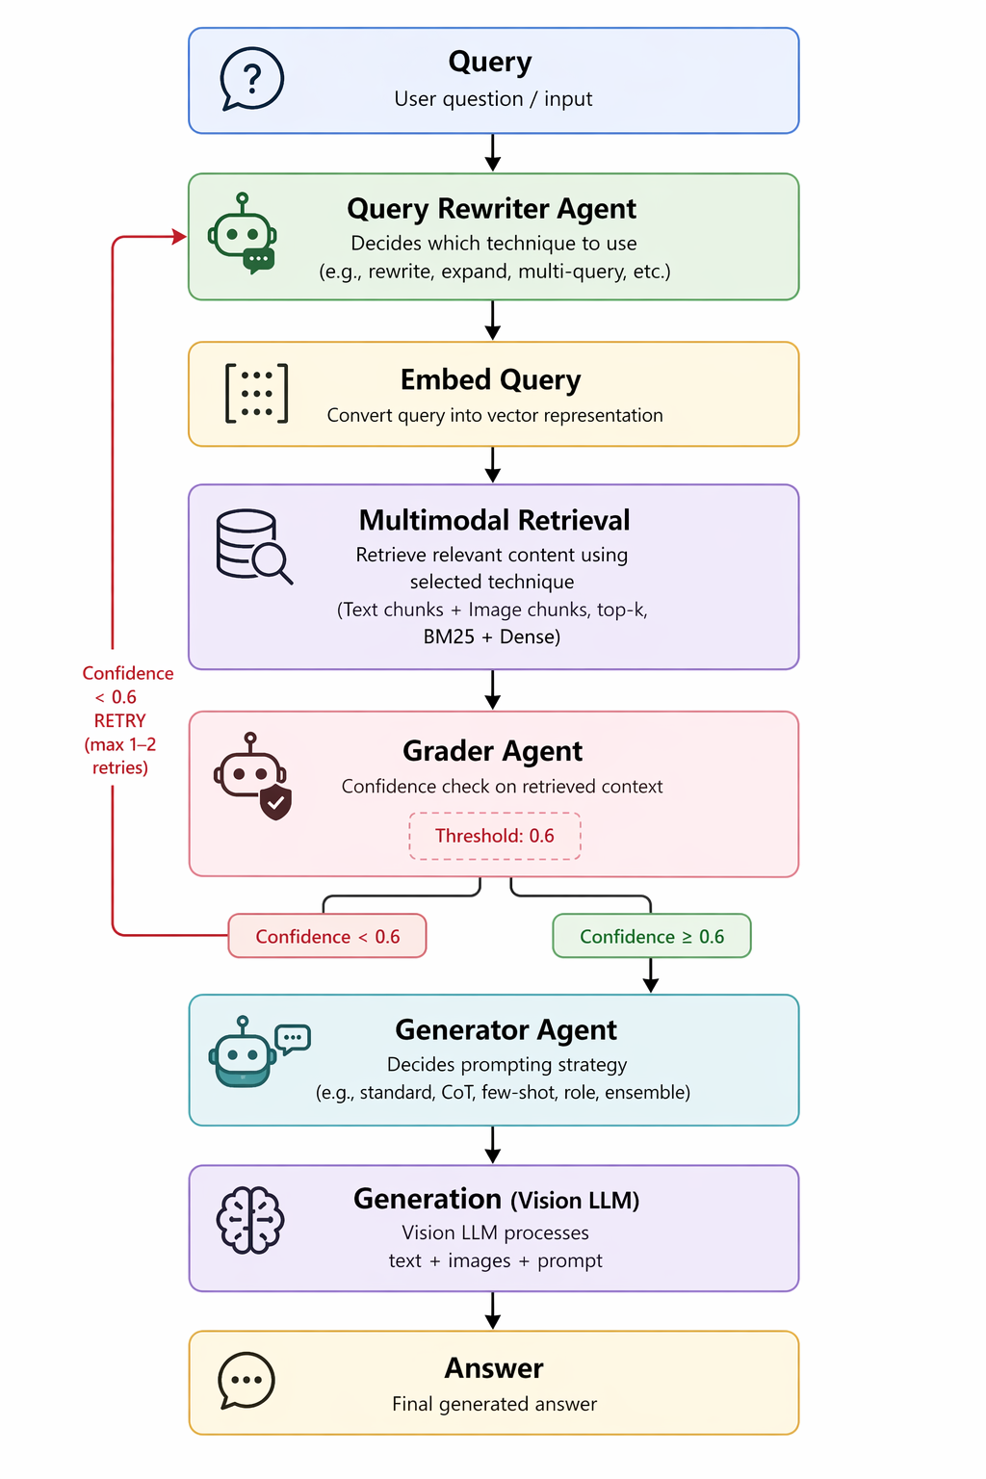
System 3. Agentic mRAG
Three Agents:
Query Rewriter
Grader
Generator
LLM-based decision making
LangChain, LangGraph (StateGraph)
For control flow, state management and orchestration
Confidence-based retry-mechanism
Structured Agent Outputs (Pydantic models/schemas)
Capture reasoning, confidence and choices/decisions
Complete Decision Audit Trail
State accumulates all agent reasoning for potential auditing purposes

Slide 18
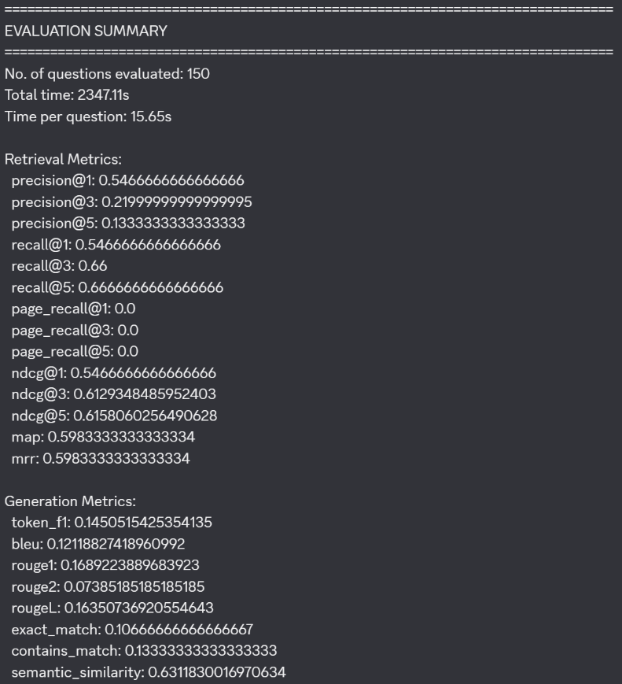
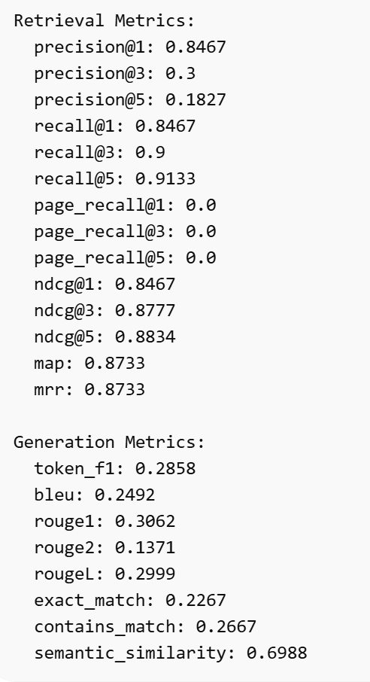
System 3. Agentic mRAG
System 3
System 2
Retrieval dominance: System 2 retrieves the correct document in 91.3% of cases (top-5) vs. System 3's 66.7% — System 3 fails entirely 1 in 3 times; maybe root cause of downstream failures
Document ranking quality: System 2's MAP/MRR of 0.873 vs. System 3's 0.598 means System 2 surfaces the correct document ~50% faster (avg rank 1.15 vs. 1.67).
Generation quality gap: System 2 achieves double the lexical overlap (Token F1 0.286 vs 0.145) and produces perfect matches twice as often (22.7% vs 10.7%).
Cascading errors: Bad query rewriting → poor retrieval → garbage context for generation. System 2's fixed pipeline avoids this error cascade entirely.

Slide 19
Final conclusion
System | Chunk | Prompt | Query | Precision@1 | Recall@1 | Exact Match | Token F1
1 | Fixed-Size | Standard | Standard | 0.5200 | 0.5200 | 0.1200 | 0.1593
2 | Fixed-Size | CoT | Standard | 0.8467 | 0.8467 | 0.2267 | 0.2858
3 | Semantic | LLM | LLM | 0.5466 | 0.5466 | 0.1067 | 0.1451

Slide 20
General adoptions and lessons learnt
Programming:
Single source of truth through config and inheritance solves a lot of bug issues
Caching all results incrementally is key for speed and motivation
Going back to redefine preprocessing multiple times is very important
Docling > Unstructured > pdfplumber for pdf preprocessing
A combination of intuition rather than a programmatic approach can be better when deciding on combination of strategies

Slide 21
What is missing / Improvements
Given more time we would have:
Followed the Strategy pattern for improved modularity, using a single mRAG class that accepts initialized components as inputs.
Considered combined the strategies in all possible combinations to optimize a weighting of different metrics (precision, f1_score, ..)

